Slide 1
Advanticsys
Weekly update – 28/04/2023
Plan for final product:
Input Data
Data processing
Output data
Design of dashbroad

Slide 2
Input data
Total 34 input files
Inverter_Today_Energy x 10 files
Inverter_Total_Energy x 10 files
Inverter_Temp x 10 files
WMS1_Temp. x 1 file
WMS1_irradiance x 1 file
WMS2_Temp x 1 file
WMS2_Irradiance x 1 file

Slide 3
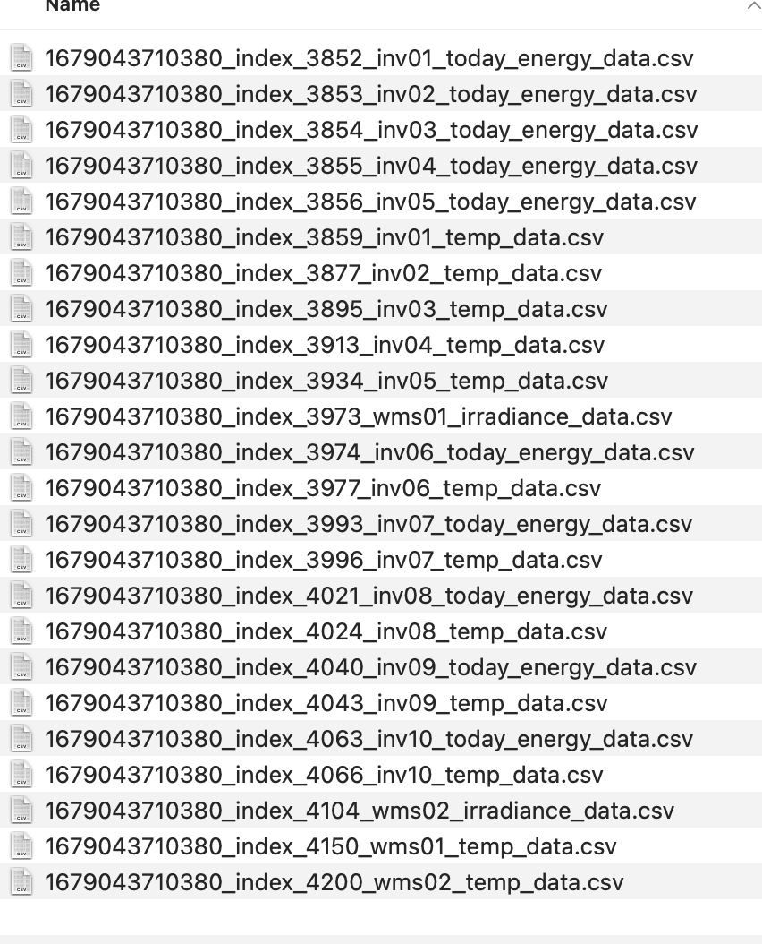
Input data

Slide 4

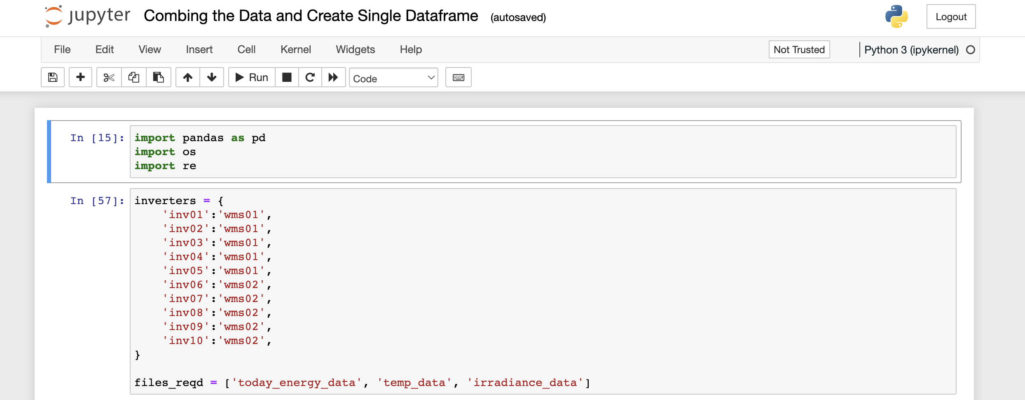
Data Processing
Tool : Jupyter Notebook
Working file: ipynb file – load data from github/drive, remove outliers and create single dataframe include all output data save to csv file

Slide 5
Output Data (single dataframe save in csv file for dashbroad building)
Apply suitable ML model to predict power generation based on historical data (inverter, time, temperature, irradiance)

Slide 6

Dashboard Creation
Visualisations:
Heatmap to show power generation for each inverter for a selected time frame
Trend graphs show inverter power generation for a selected timeline, will also show correlation between temp/irr and power generation
Actual deviation from prediction for each inverter
Trend line to show power generation decline(increase) through time, the slope of the trend line can be used to identify aging of panel/inverter
Tool: Tableau

Slide 7

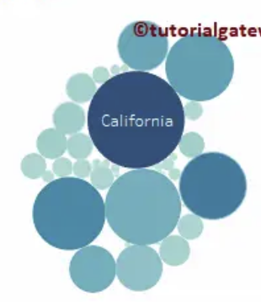
Dashbroad design
Select start date and time
Select end date and time
Dashbroad 1: bubble chart
XX MWh

Slide 8
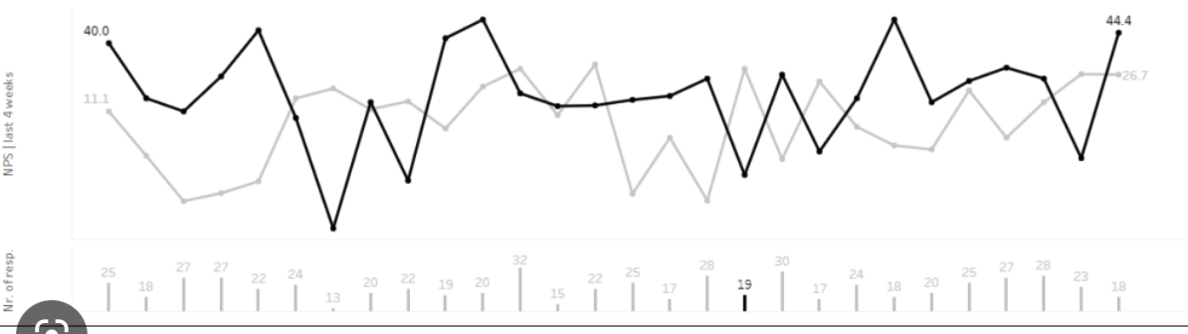
Dashbroad design
Select start date and time
Select end date and time
Inv 1
Inv 2
Dashbroad 2: Line chart with bars show Temp/Irr
Irradiance
Inv 1
Inv 2
Temperature

Slide 9
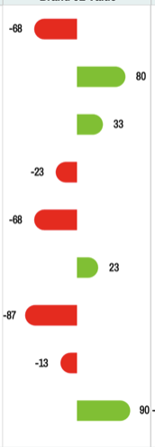
Dashbroad design
Select start date and time
Select end date and time
Inv 2 +80%
Prediction as base line, show deviation in % for each inverter
Bar chart 1:
Dashbroad 3: bar chart show deviation from prediction
Inv 1 -70%
Select Inverter No.
Select start date and time
Select end date and time
Inv 1
Bar chart 2:
Prediction as base line, show deviation in % for selected inverter
day 1
day 2
day 9

Slide 10
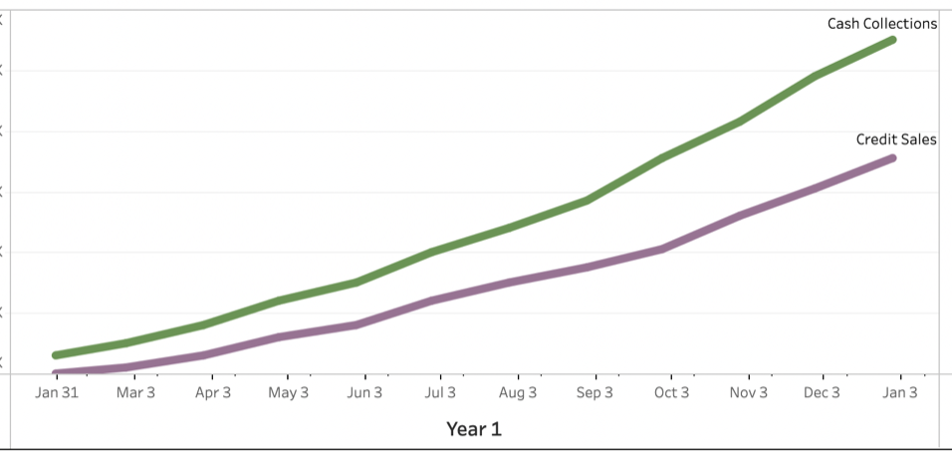
Dashbroad design
Select Inverter, allow multiple selection
Select start date and time
Select end date and time
Inv 1, inv 2
Inv 1 total energy
Dashbroad 4: trend graph to show power generation change through time
Inv 2 total energy
Inv2 show flat, the total energy generation become less and less when compare to Inv1, means the capacity decline faster than Inv1

